Slide 1
Recommender System
Corrie Meyersick
MSDS696 Data Science Practicum II
Week 4 Update
08/21/2019

Slide 2
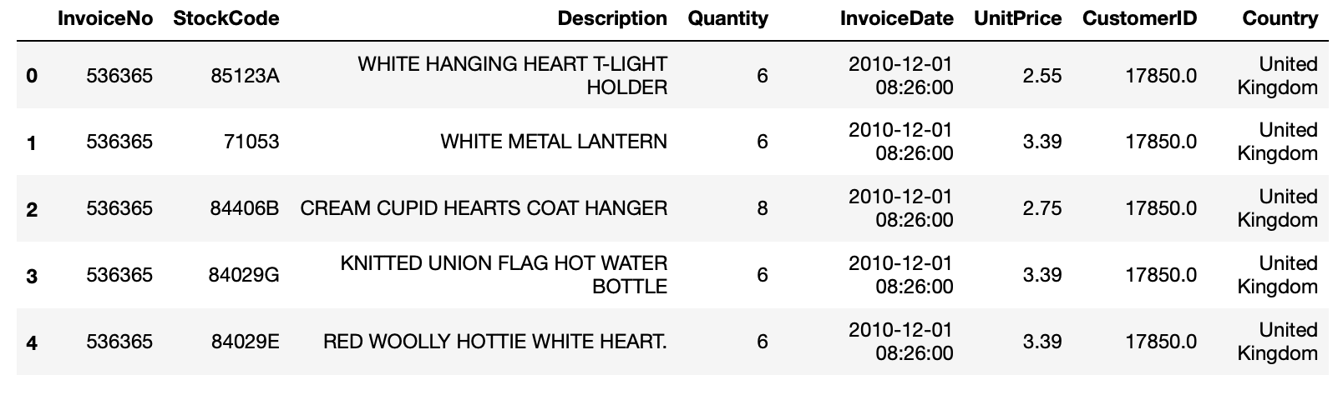
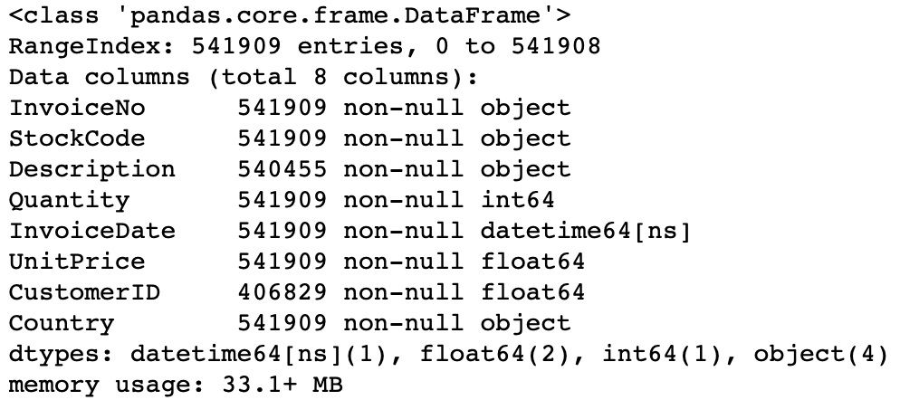
Project Summary
The purpose of this project is to use the data retrieved from UCI Machine Learning Repository, which consist transactional data, to build a recommender system.
Data set consists of 541,909 transactions and the following attributes:
Invoice number
Stock number
Description
Quantity
Invoice Date
Unit Price
Customer ID
Country

Slide 3
Project Plan
The following steps were used on this project:
Data collection
Data cleaning
Exploratory Data Analysis
Evaluate model performance and determine best model
Apply machine learning model to data for recommender system

Slide 4
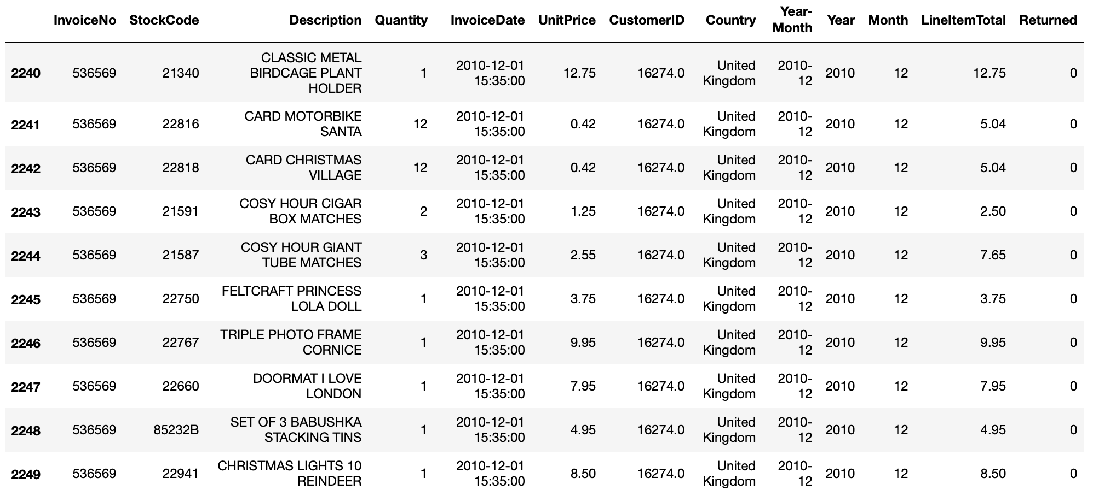
Data Preparation
Missing values
Data type conversion (datetime, string, int64)
Additional columns: Year-Month, Month, Year, Returned, line item totals, order total
Removing unwanted items: discounts, commission, postage, fees, gift cards, etc.

Slide 5
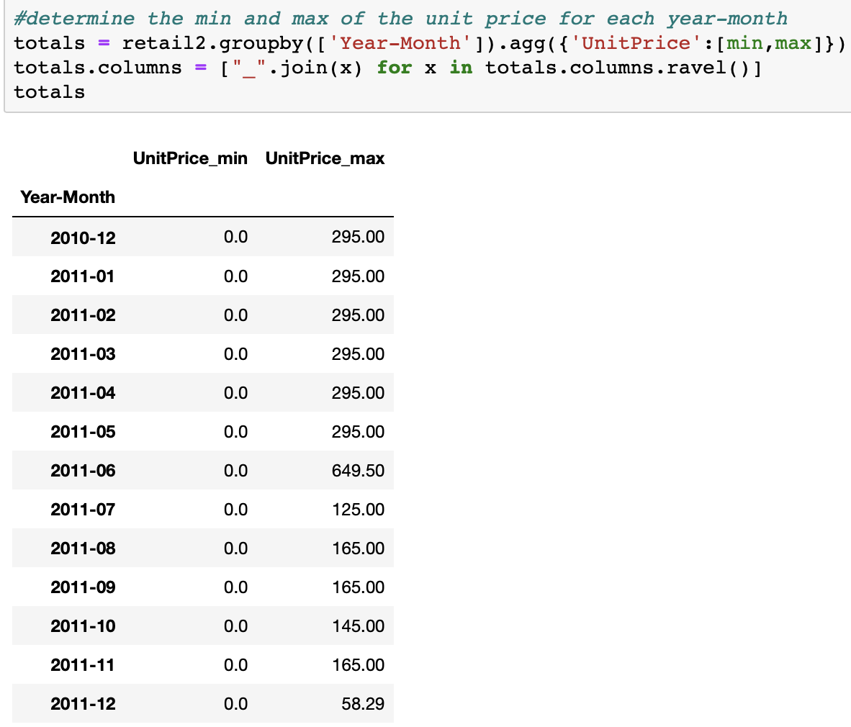
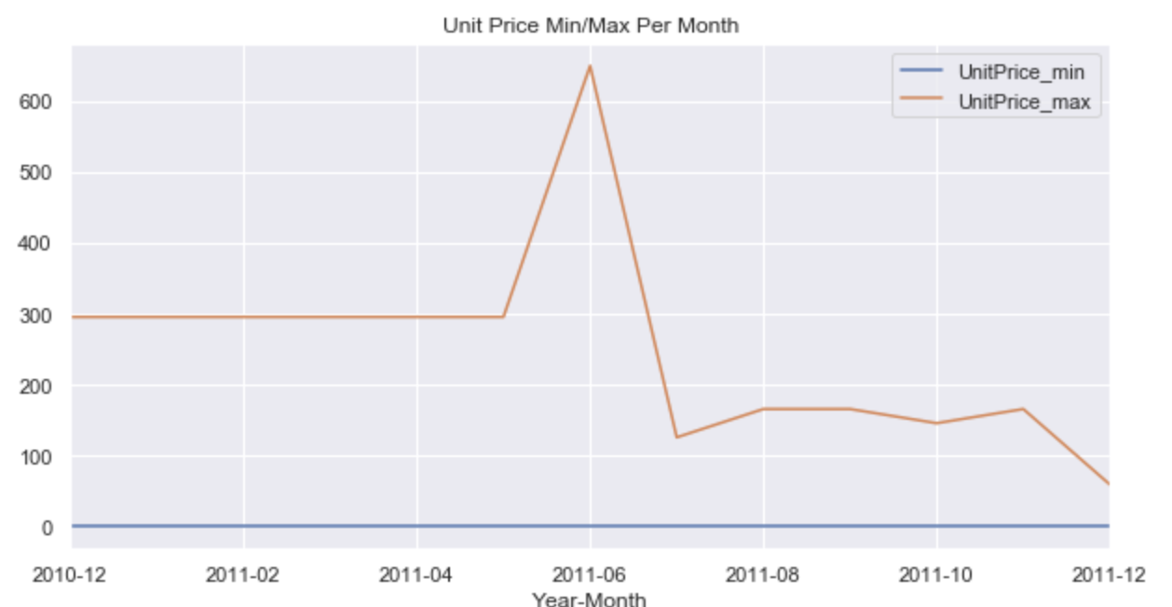
Exploratory Data analysis

Slide 6
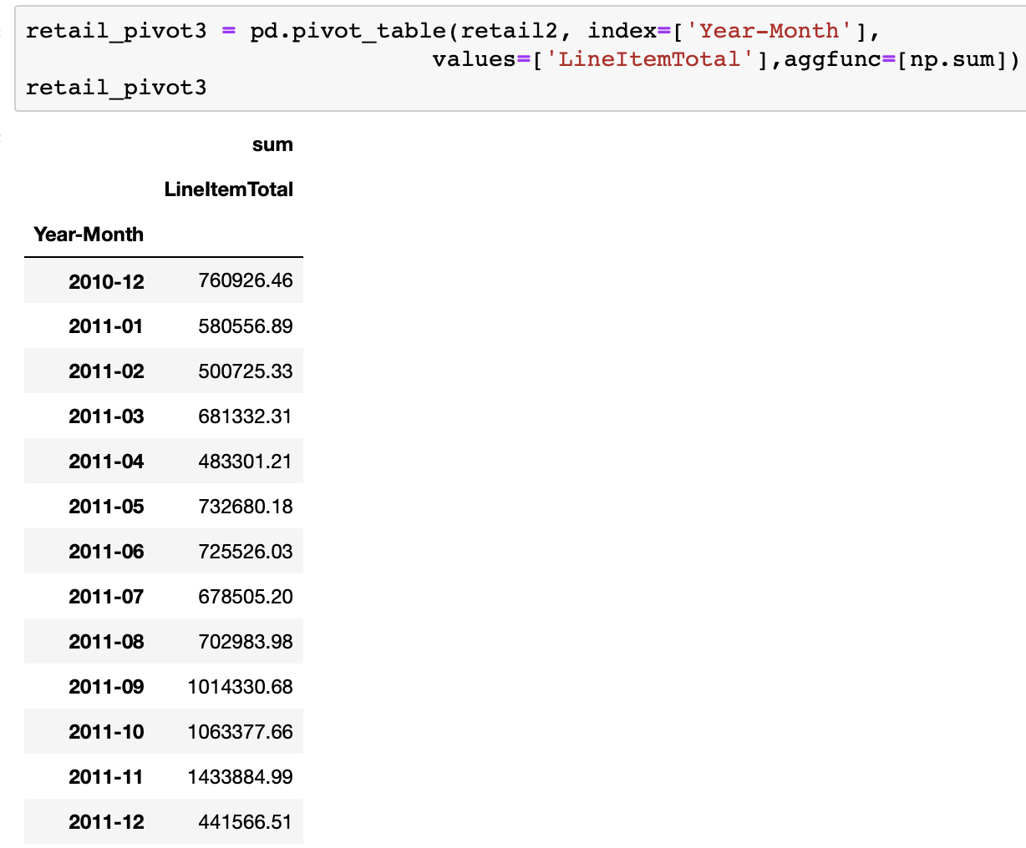
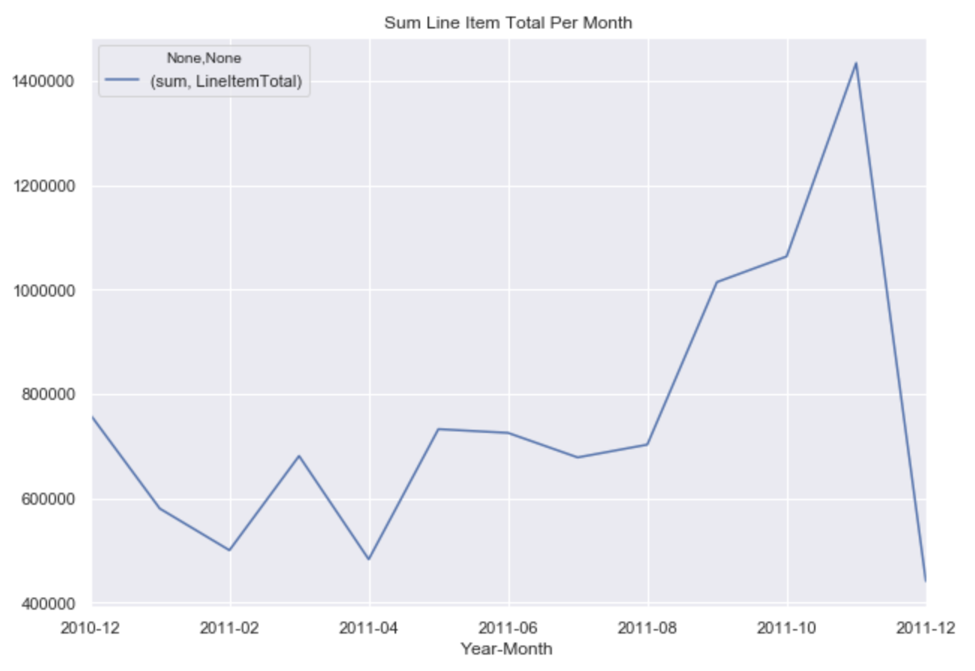
Exploratory Data analysis

Slide 7
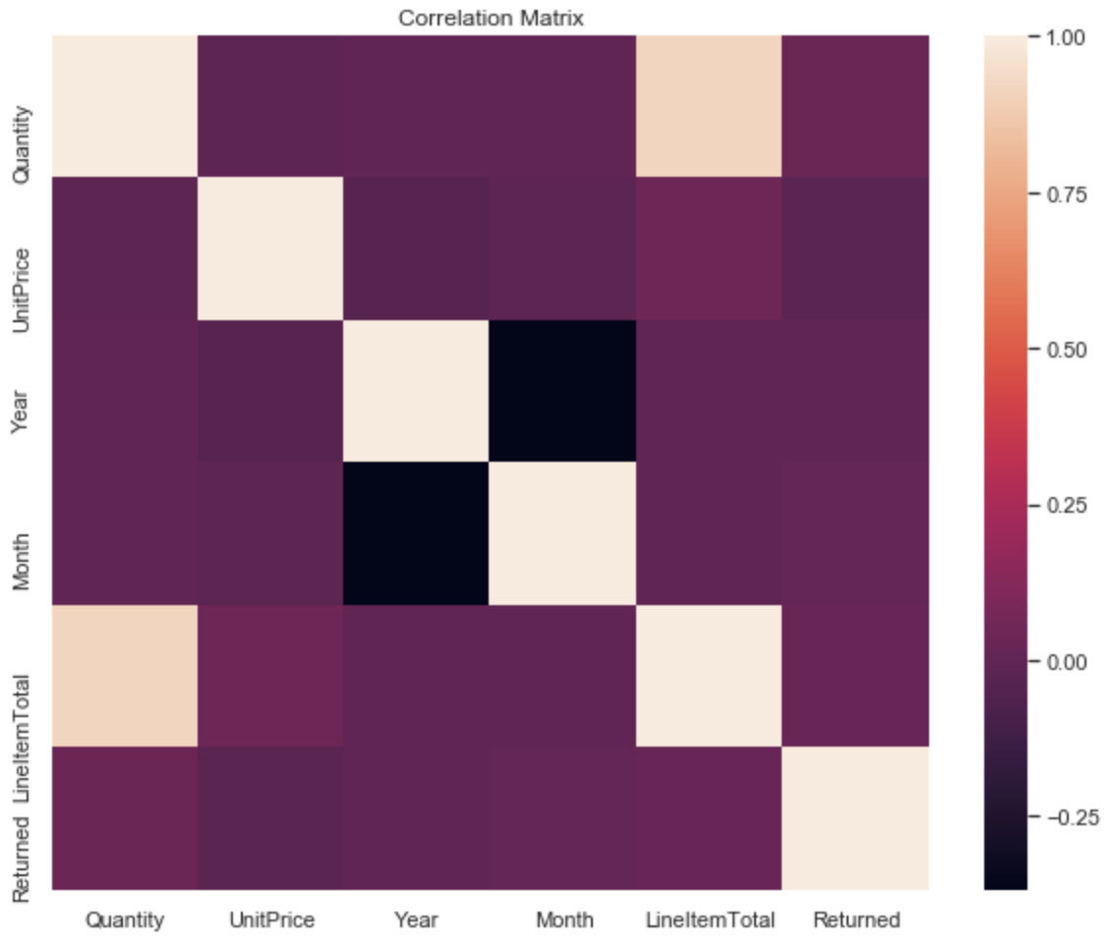
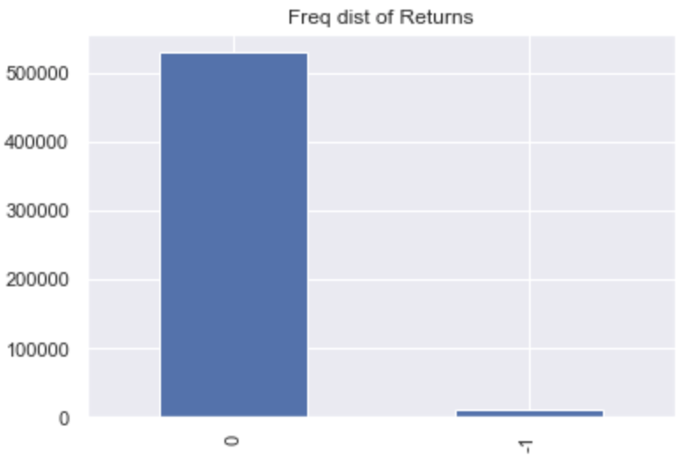
Exploratory Data Analysis

Slide 8
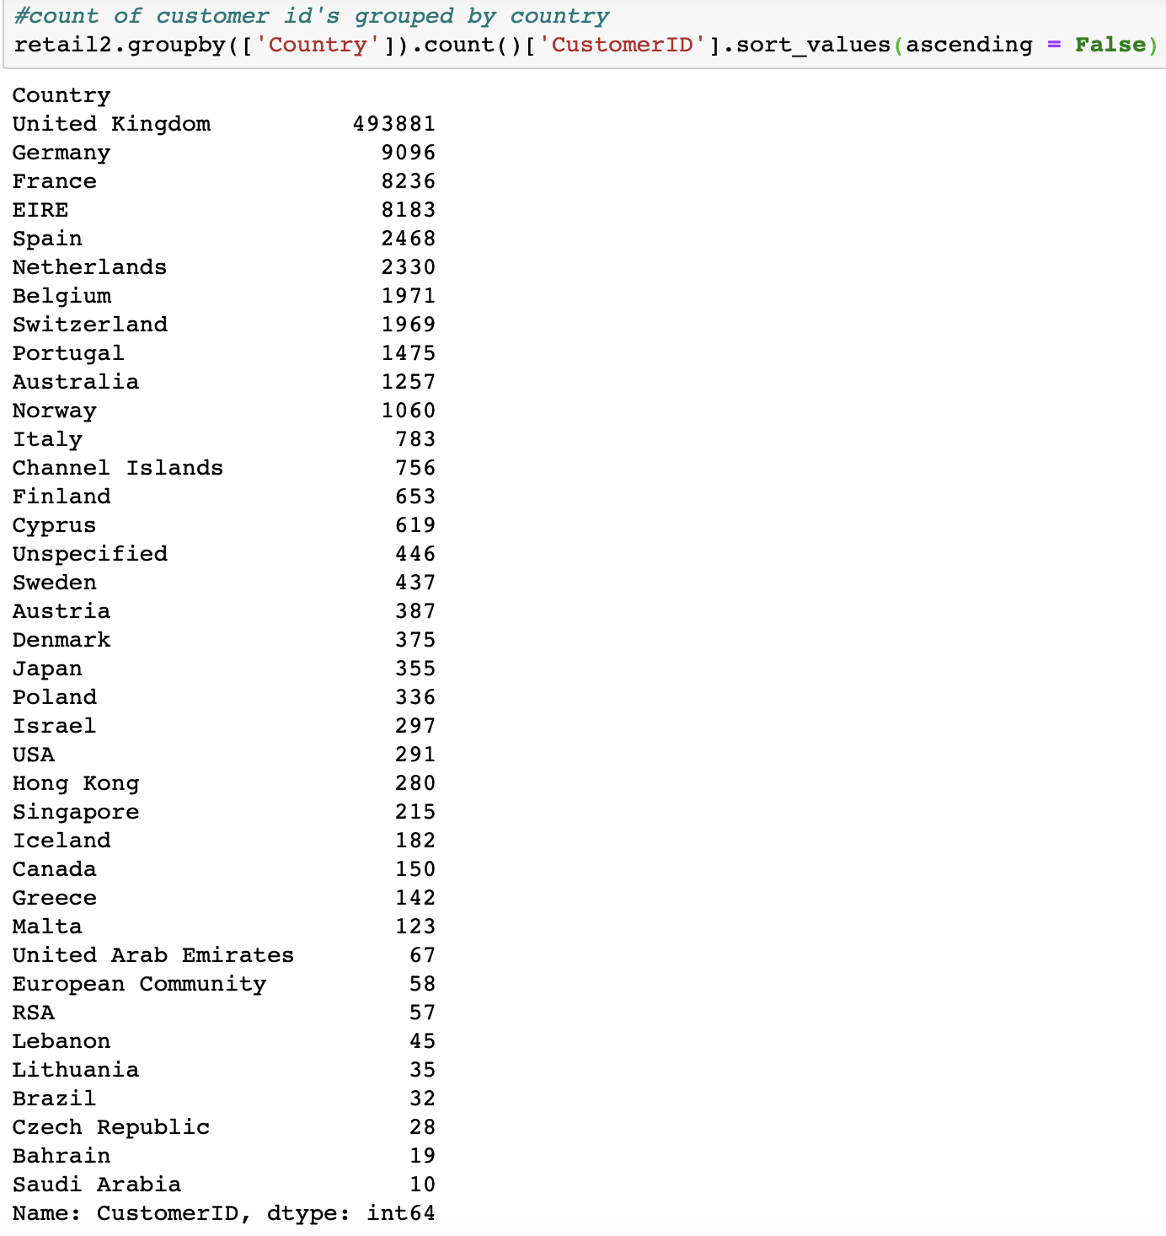
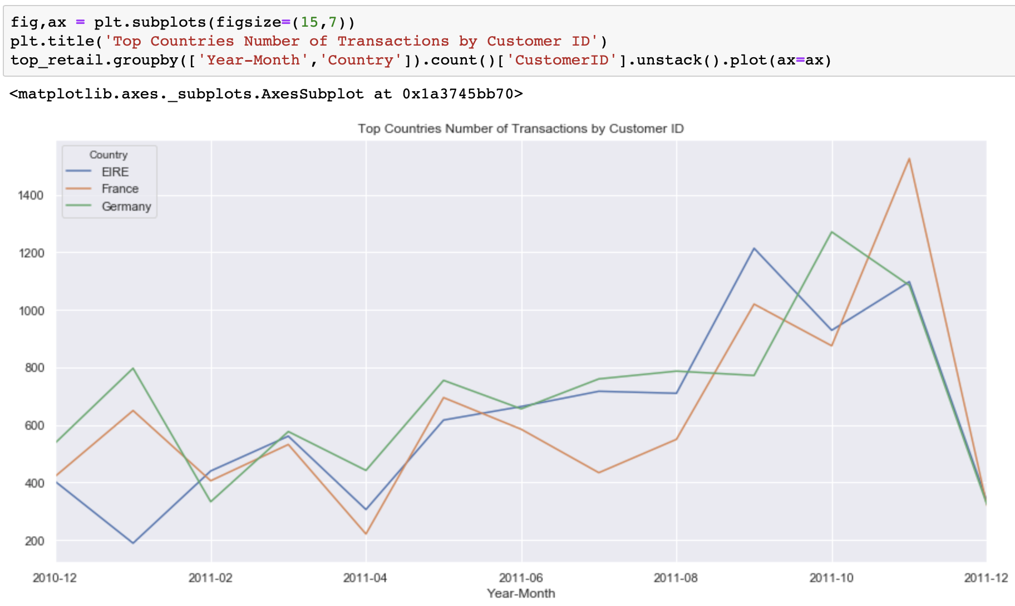
Exploratory Data Analysis

Slide 9
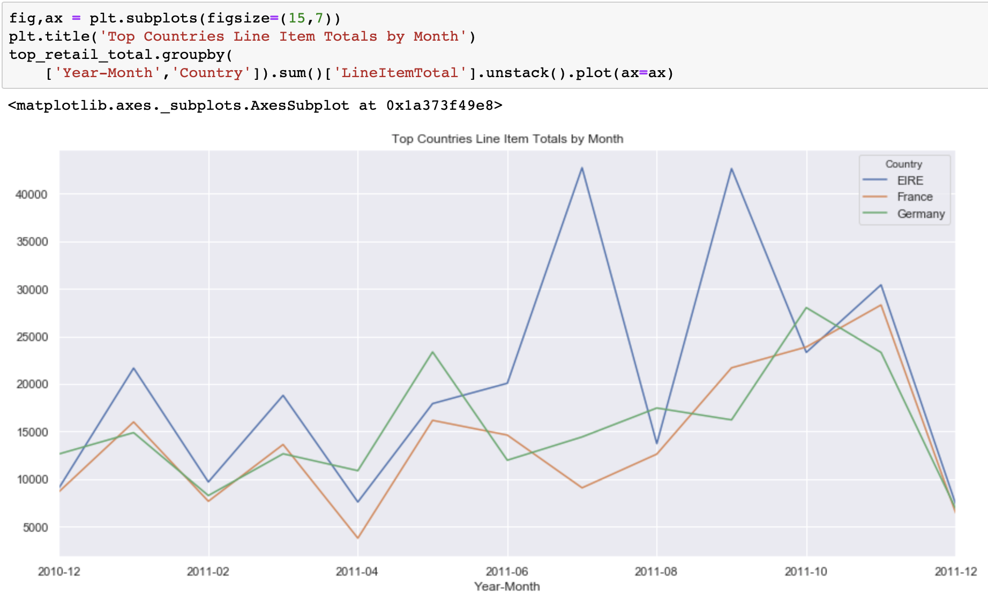
Exploratory Data Analysis

Slide 10
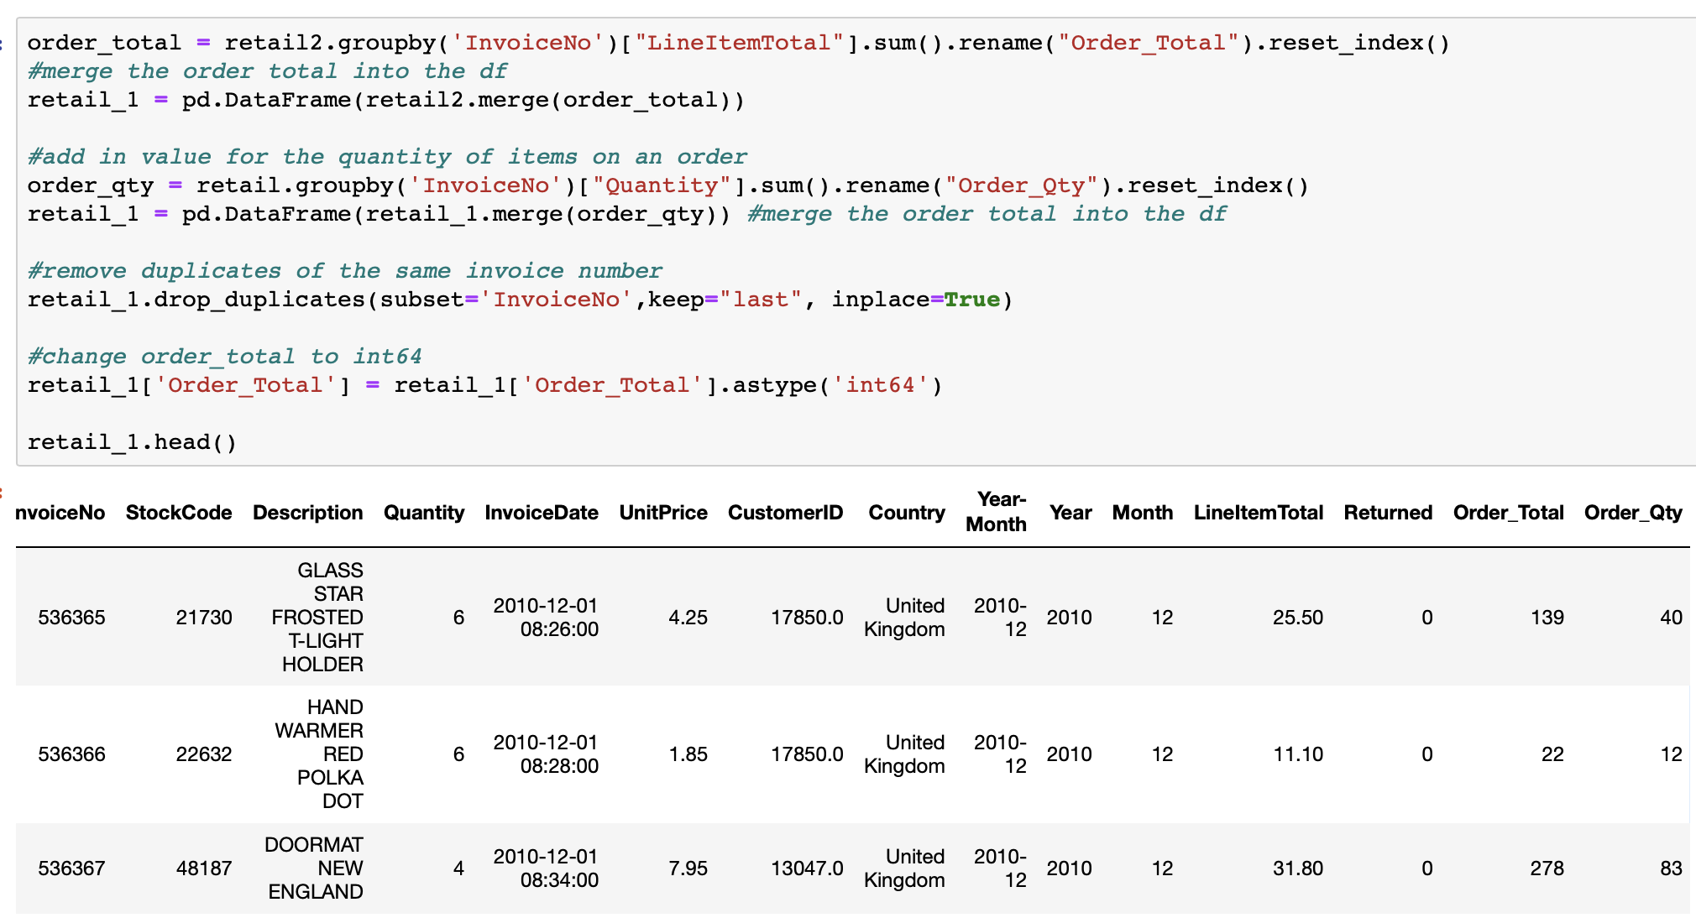
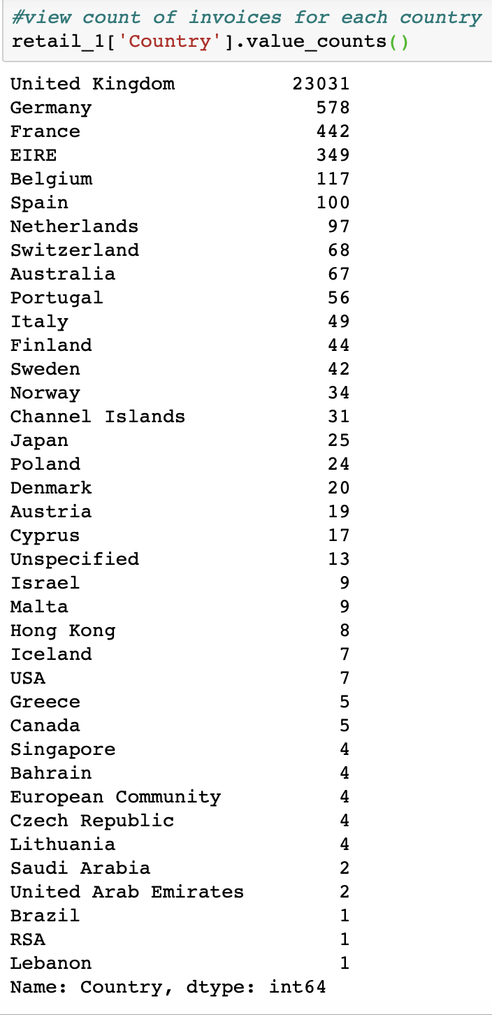
Exploratory data analysis

Slide 11
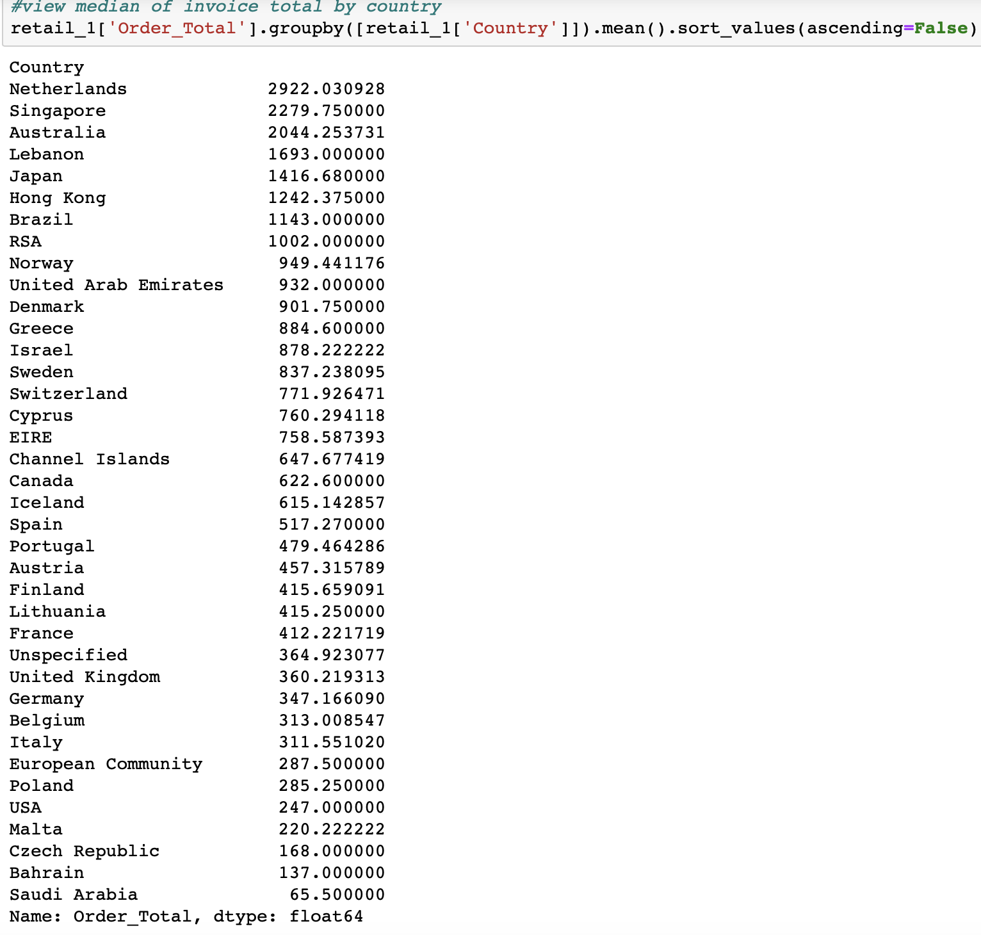
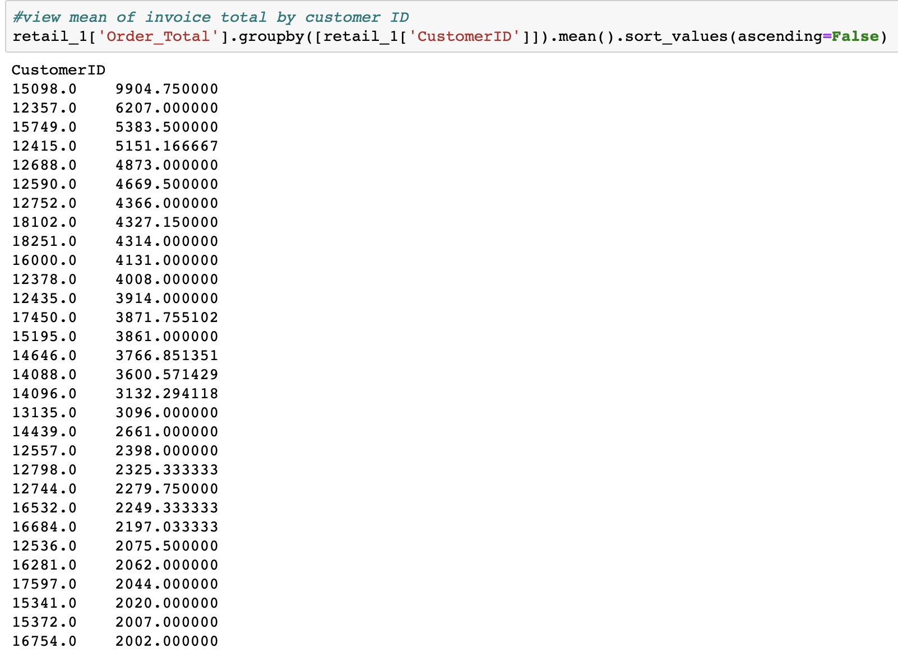
Exploratory data analysis

Slide 12
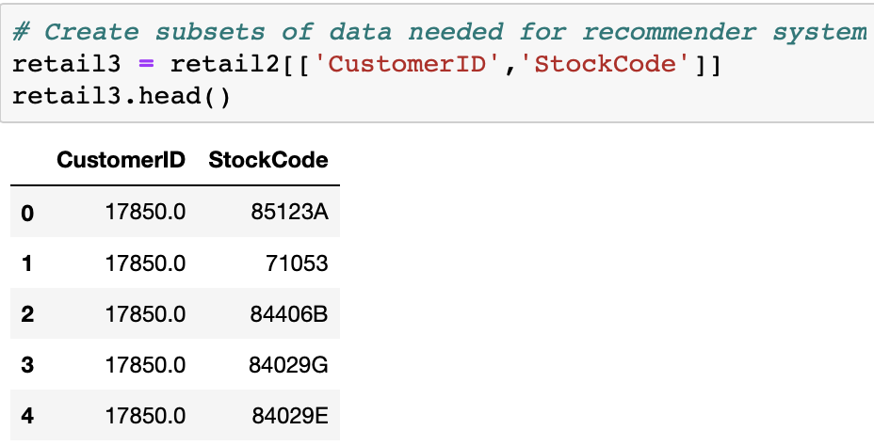
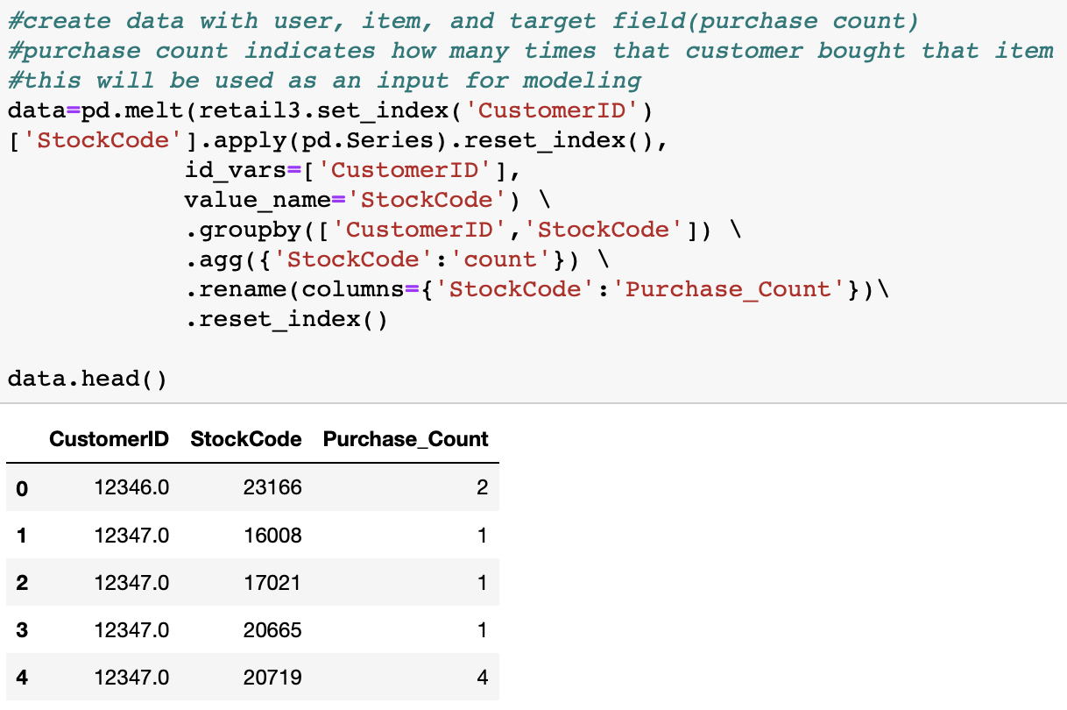
Recommender System

Slide 13
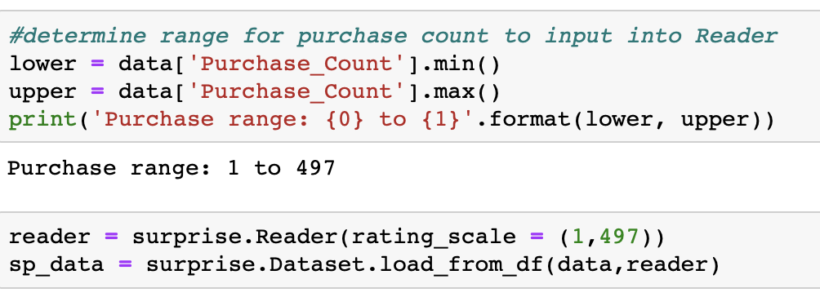
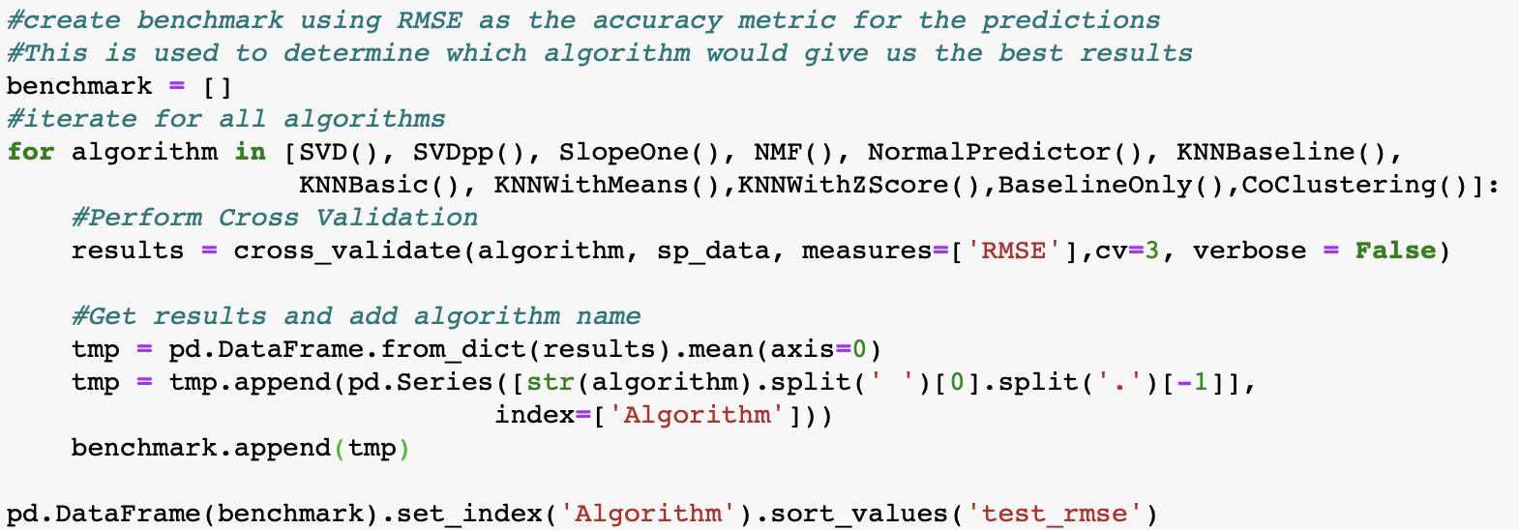
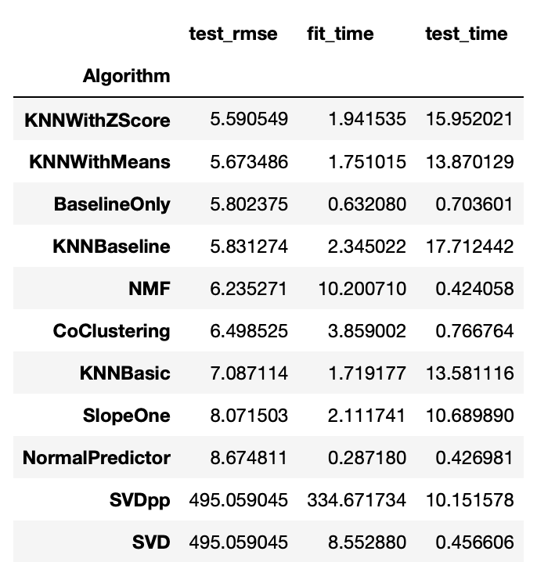
Recommender System

Slide 14
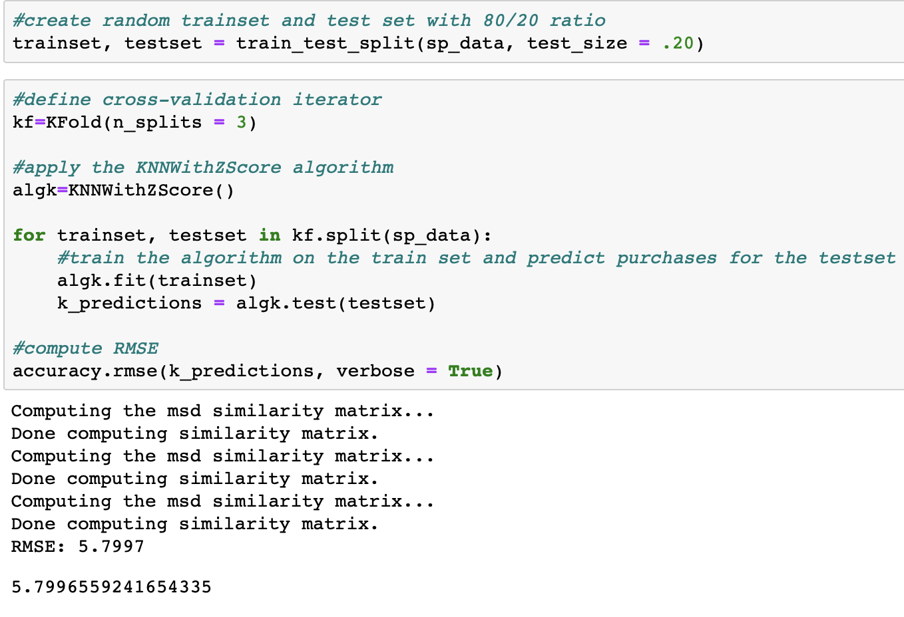
Recommender System

Slide 15
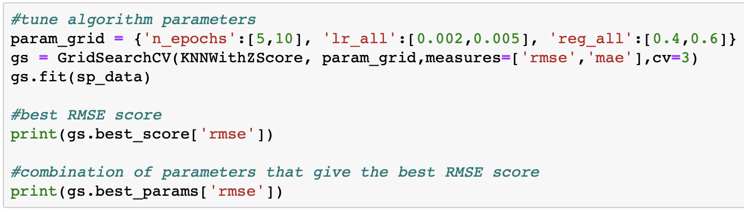
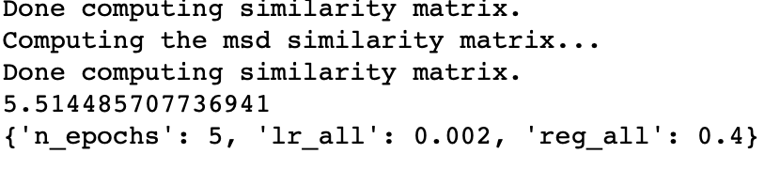
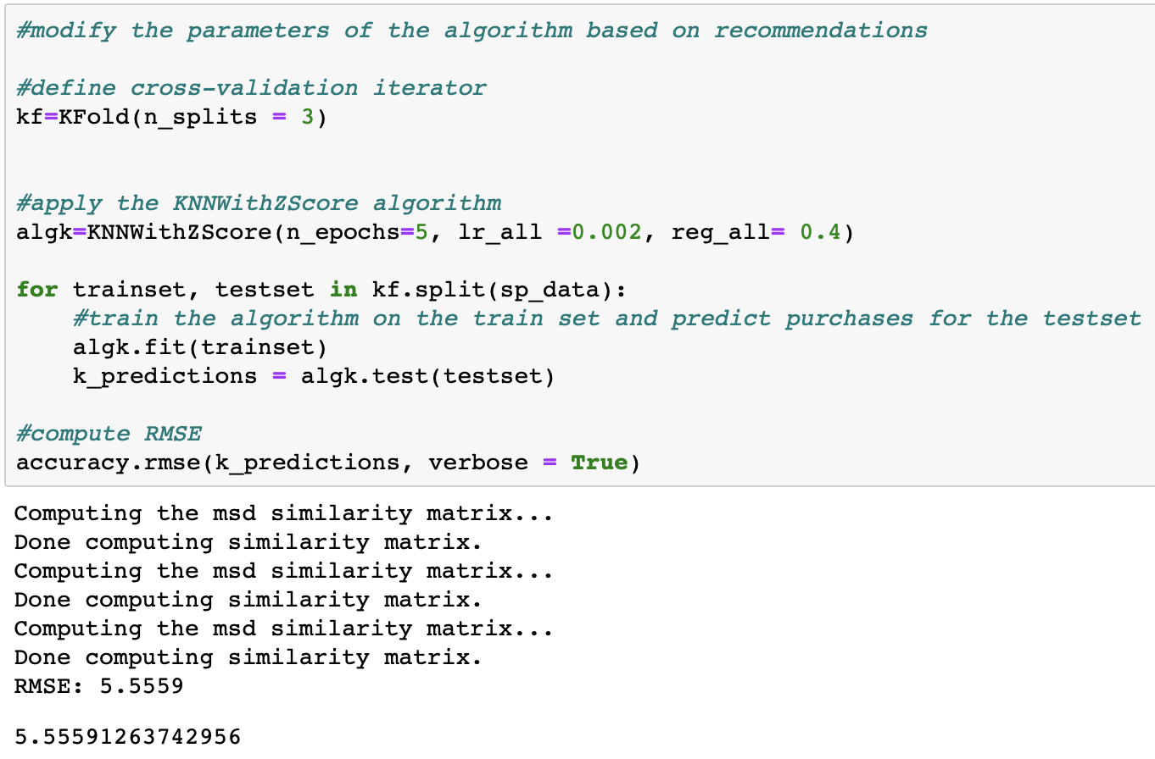
Recommender System

Slide 16
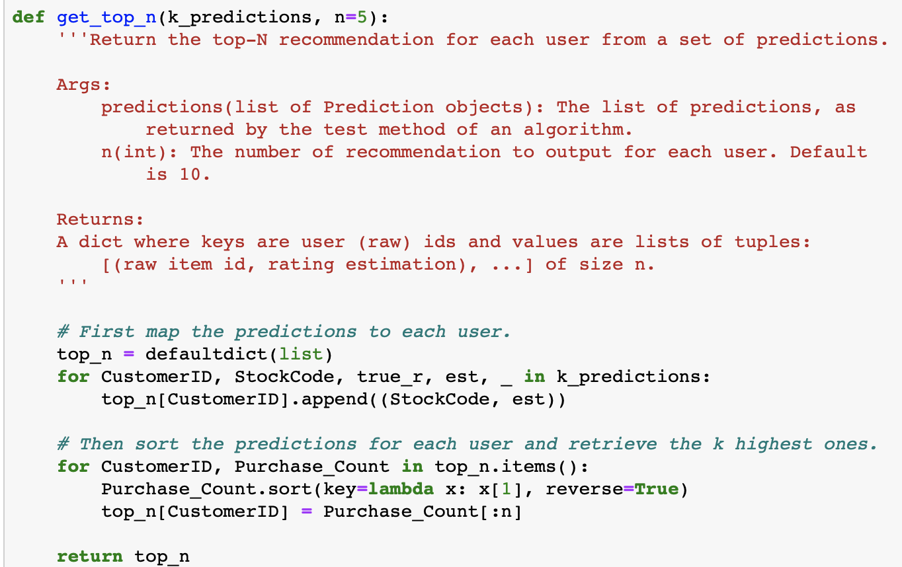
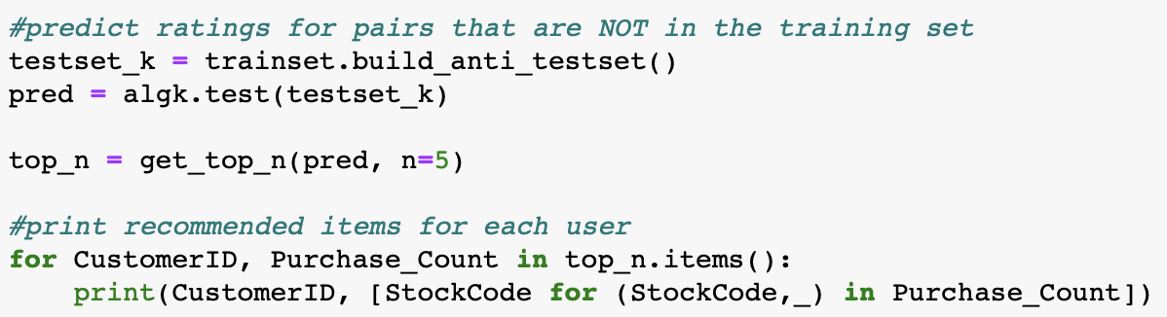
Recommender System

Slide 17
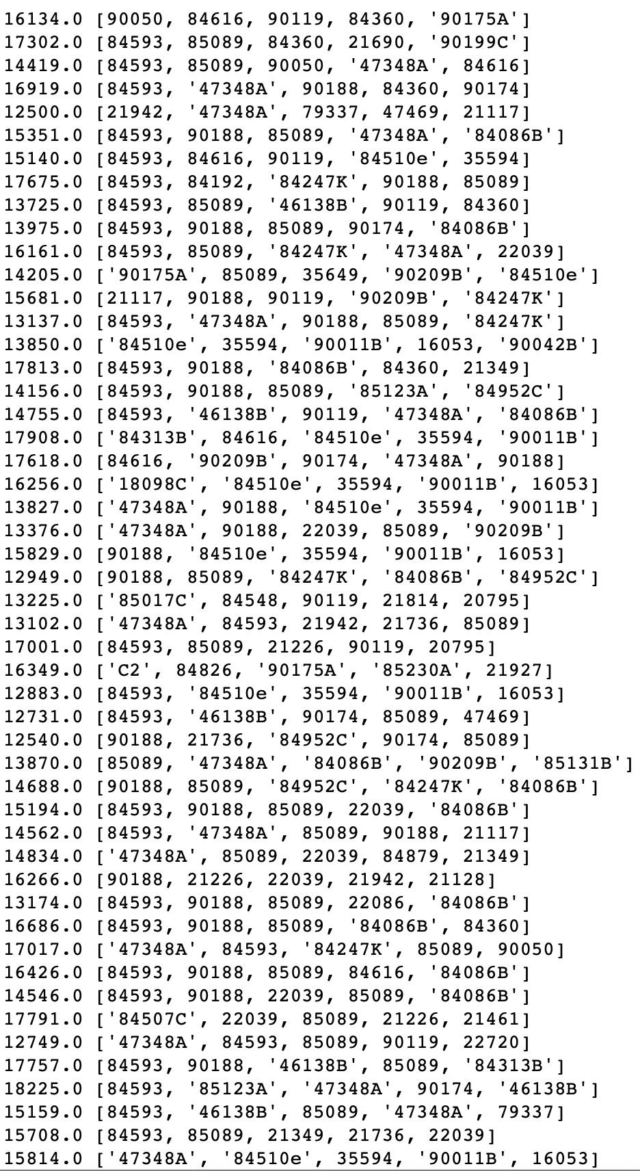
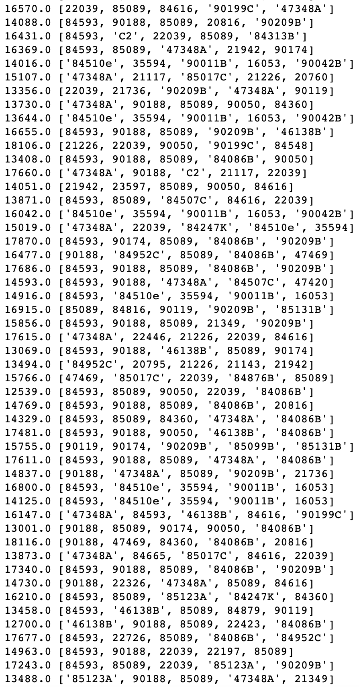
Recommender System top 5 Results

Slide 18
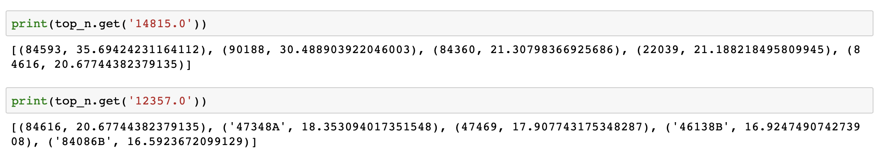
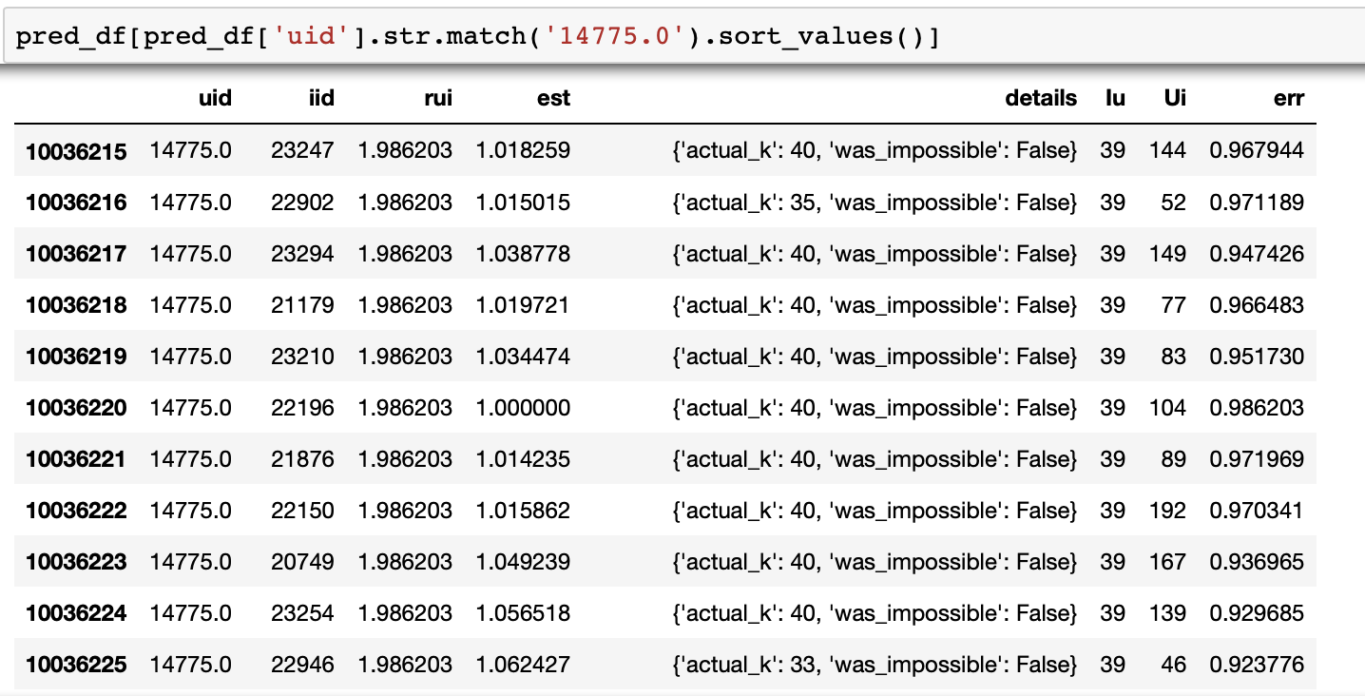
Recommender Results

Slide 19
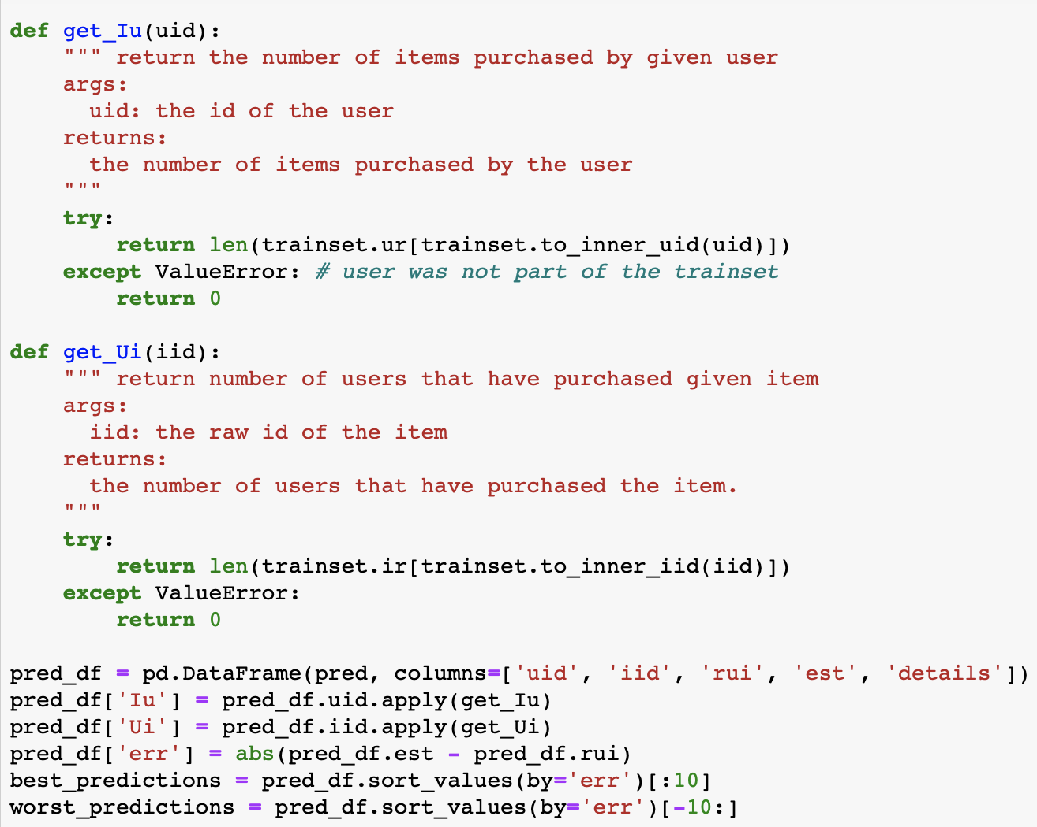
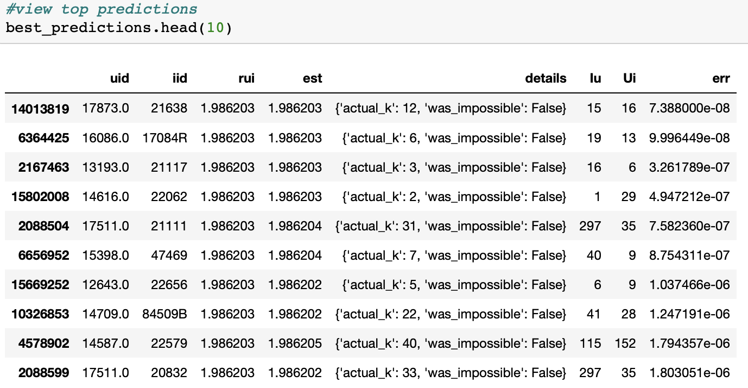
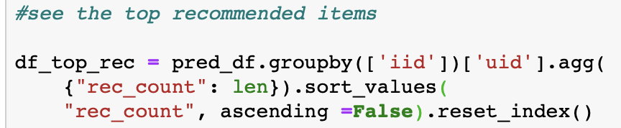
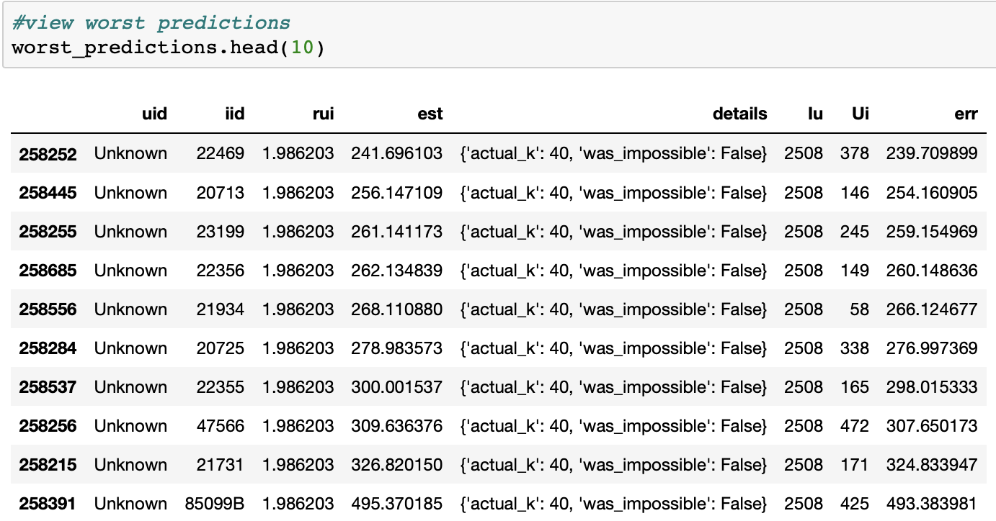
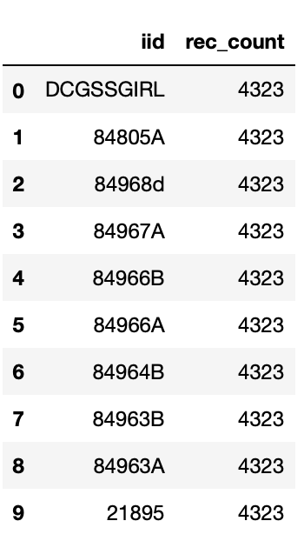
Best / Worst Predictions

Slide 20
Overall Conclusions
The online retail dataset provided by UCI Machine Learning Repository contained a lot of useful information; more so than just for building a recommender system.
Although there are a number of different methods that can be applied in order to build a recommender system, the method that demonstrated the best results was the KNN With Z Score.
Applying the KNN with Z Score method to the dataset in order to build the recommender system, we were able to see the top 5 item recommendations for each customer. This could spur additional sales by customers through the recommendation of similar items that they have purchased but hadn’t considered purchasing before.

Slide 21
References
Baker, J. (2018). Practical Introduction to Recommender Systems. Retrieved from
https://cambridgespark.com/practical-introduction-to-recommender-systems/
Bungaro, L. (2018). How Recommender Systems Works (Python Code – Example Film Recommender). Retrieved from
https://medium.com/coinmonks/how-recommender-systems-works-python-code-850a770a656b
Hug, N. (2015). Welcome to Surprise’ documentation! — Surprise 1 documentation. Retrieved from
https://surprise.readthedocs.io/en/stable/index.html
Li, Susan. (2018). Building and Testing Recommender Systems with Surprise. Retrieved from
https://towardsdatascience.com/building-and-testing-recommender-systems-with-surprise-step-by-step-d4ba702ef80b
Liao, K. (2018). Prototyping a Recommender System Step by Step Part 1: KNN Item-Based Collaborative Filtering. Retrieved from
https://towardsdatascience.com/prototyping-a-recommender-system-step-by-step-part-1-knn-item-based-collaborative-filtering-637969614ea
Rocca, B. (2019). Introduction to Recommender Systems. Retrieved from
https://towardsdatascience.com/introduction-to-recommender-systems-6c66cf15ada

